Slide 1

Image Encryption & Statistical Randomness
A Comprehensive Evaluation of AES, RSA, and the NIST STS

Slide 2






The Three Core Pillars
AES Encryption
RSA Signature
NIST Evaluation
Securing a payload using a 128-bit key across ECB, CBC, CFB, and OFB block modes.
Hashing the ciphertext via SHA-1 and guaranteeing authenticity with a 2048-bit RSA key pair.
Mathematically validating entropy using the official NIST Statistical Test Suite.

Slide 3


Task 1: AES Encryption
We selected a standard .bmp image as our plaintext baseline.
To preserve visual rendering, we stripped the 54-byte BMP header before applying the AES cipher.
The raw pixel body was padded and encrypted using AES-128.
Reattaching the header produced viewable ciphertexts, allowing us to physically inspect diffusion.

Slide 4
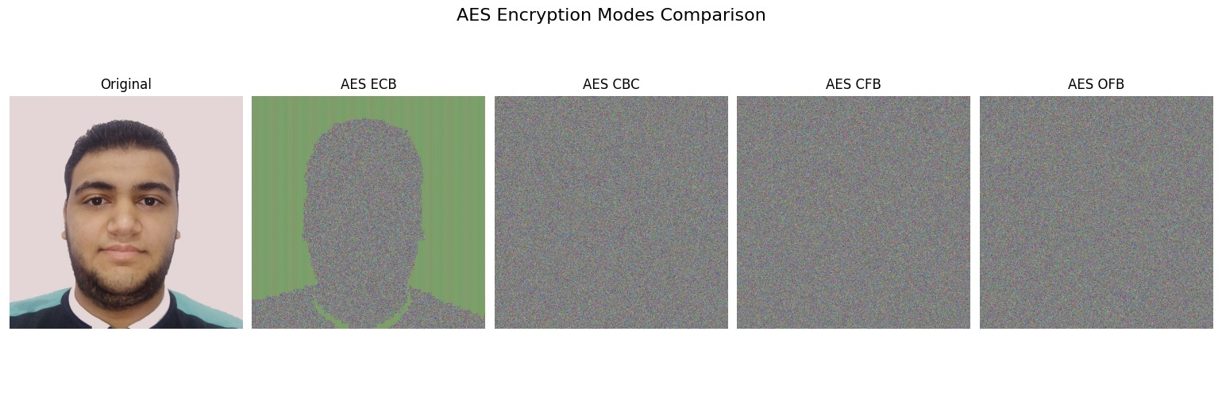
AES Encryption Results

Slide 5
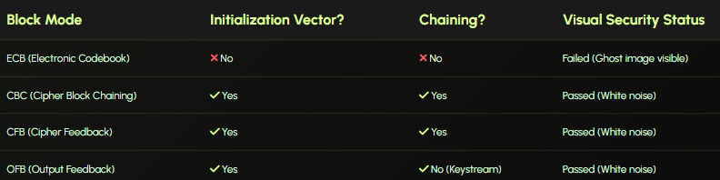
AES Block Modes Compared

Slide 6
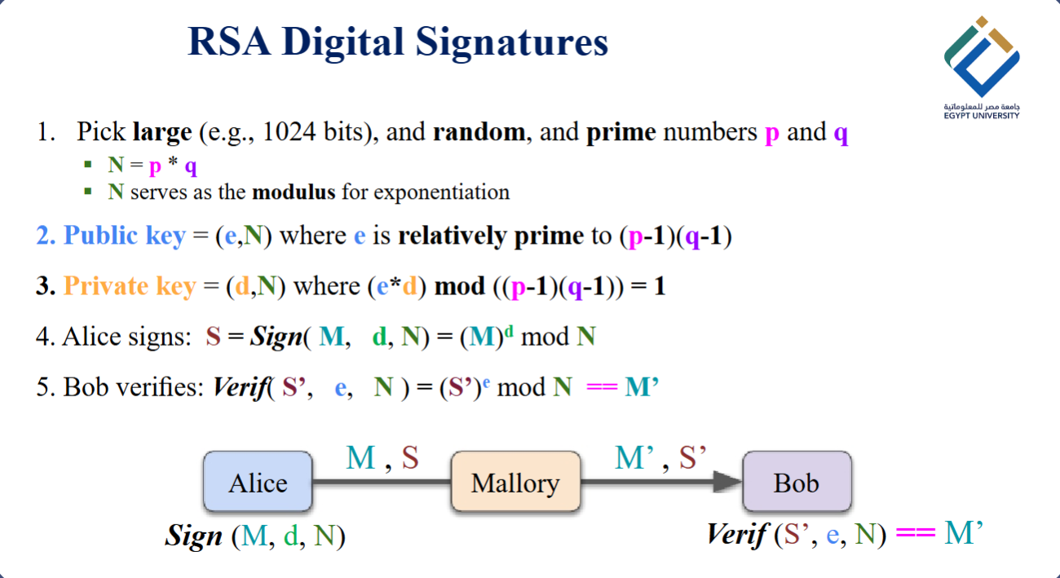
Task 2: RSA Signature
Key Generation: Created a robust 2048-bit RSA Public/Private key pair.
Hashing: Computed a SHA-1 hash for the CBC-encrypted image payload.
Signing: Encrypted the hash with the private key (PKCS#1 v1.5 padding).
Verification: The public key successfully decrypted the hash, confirming absolute data integrity.

Slide 7
Task 3: NIST STS Evaluation
Validating ciphertext entropy using the official 15-test governmental standard.

Slide 8
0.62%
98.94%
NIST Statistical Pass Rates
3.09%
AES-CBC
Effectively scatters bits
98.94%
Original Image
Spectacularly failed randomness tests due to structural predictability and repeating pixel patterns.
AES-CFB
Effectively scatters bits
0.62%%
99.47%
AEC-ECB
AES-OFB
It preserved patterns from the original image
Spectacularly failed randomness tests due to structural predictability and repeating pixel patterns.

Slide 9

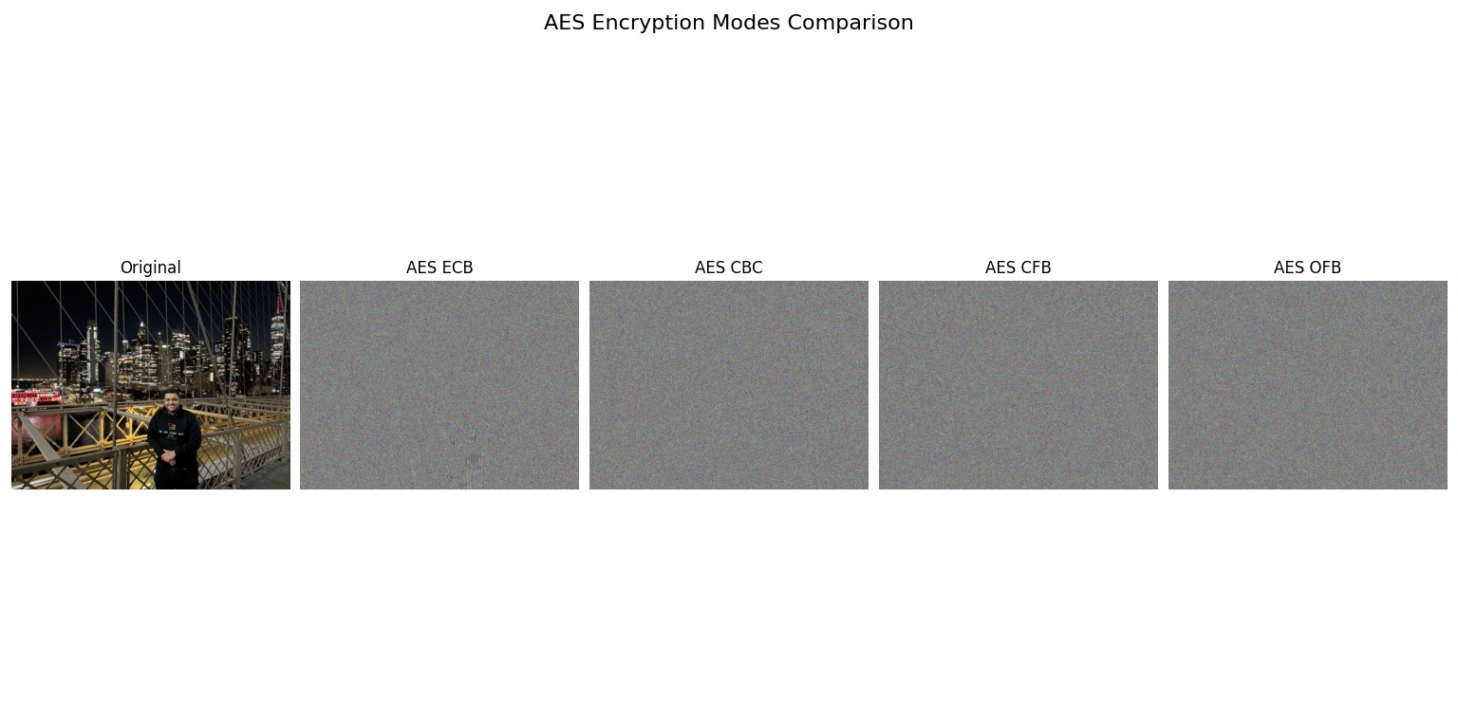
Interesting Observation
ECB Performs really well and achieves same randomness as other algorithms if the image has many

Slide 10
Final Conclusion
CBC, CFB, and OFB are the clear winners. By utilizing Initialization Vectors and chaining mechanisms, they achieve maximum cryptographic diffusion.
Math matches reality. The encrypted outputs are statistically indistinguishable from true random white noise, passing ~99% of tests.
ECB can be used in case an image has many details
Authentication is critical. Implementing RSA signatures over SHA-1 guarantees that the randomized ciphertext has not been tampered with in transit.

Slide 11
Questions?
Thank you for your attention.

